Slide 1
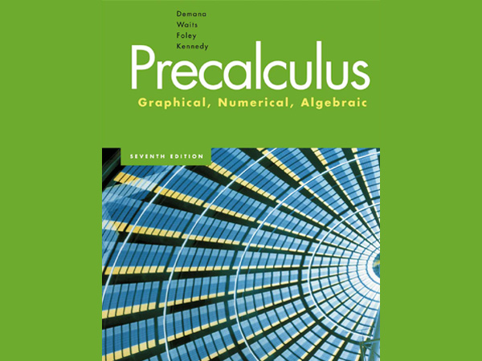

Slide 2
Chapter 5
Analytic Trigonometry

Slide 3
5.1
Fundamental Identities

Slide 4
What you’ll learn about
Students will be able to use the fundamental identities to simplify trigonometric expressions and solve trigonometric equations.
… and why
Identities are important when working with trigonometric
functions in calculus.

Slide 5
Basic Trigonometric Identities

Slide 6
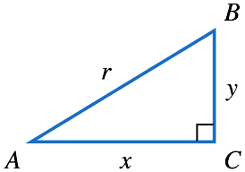
Pythagorean Identities

Slide 7
Example Using Identities

Slide 8
Example Using Identities

Slide 9
Cofunction Identities

Slide 10
Cofunction Identities

Slide 11
Even-Odd Identities

Slide 12
Example Solving a Trigonometric Equation

Slide 13
Example Solving a Trigonometric Equation

Slide 14
What you’ll learn about
Students will be able to use the fundamental identities to simplify trigonometric expressions and solve trigonometric equations.
… and why
Identities are important when working with trigonometric
functions in calculus.

Slide 15
5.2
Proving Trigonometric Identities

Slide 16
What you’ll learn about
Students will be able to decide whether an equation is an identity and to confirm identities analytically.
… and why
Proving identities gives you excellent insights into the
ways mathematical proofs are constructed.

Slide 17
General Strategies I for Proving an Identity
The proof begins with the expression on one side of the identity.
The proof ends with the expression on the other side.
The proof in between consists of showing a sequence of expressions, each one easily seen to be equivalent to its preceding expression.

Slide 18
General Strategies II for Proving an Identity
Begin with the more complicated expression and work toward the less complicated expression.
If no other move suggests itself, convert the entire expression to one involving sines and cosines.
Combine fractions by combining them over a common denominator.

Slide 19
General Strategies III for Proving an Identity
Use the algebraic identity (a+b)(a-b) = a²-b² to set up applications of the Pythagorean identities.
Always be mindful of the “target” expression, and favor manipulations that bring you closer to your goal.

Slide 20
Example Setting up a Difference of Squares

Slide 21
Example Setting up a Difference of Squares

Slide 22
What you’ll learn about
Students will be able to use the fundamental identities to simplify trigonometric expressions and solve trigonometric equations.
… and why
Identities are important when working with trigonometric
functions in calculus.

Slide 23
5.3
Sum and Difference Identities

Slide 24
What you’ll learn about
Students will be able to apply the identities for cosine, sine, and tangent of a difference or a sum.
… and why
These identities provide clear examples of how different the
algebra of functions can be from the algebra of real numbers.

Slide 25
Cosine of a Sum or Difference

Slide 26
Example Using the Cosine-of-a-Difference Identity

Slide 27
Example Using the Cosine-of-a-Difference Identity

Slide 28
Sine of a Sum or Difference

Slide 29
Example Using the Sum and Difference Formulas

Slide 30
Example Using the Sum and Difference Formulas

Slide 31
Tangent of a Difference of Sum

Slide 32
What you’ll learn about
Students will be able to apply the identities for cosine, sine, and tangent of a difference or a sum.
… and why
These identities provide clear examples of how different the
algebra of functions can be from the algebra of real numbers.

Slide 33
5.4
Multiple-Angle Identities

Slide 34
What you’ll learn about
Students will be able to apply double-angle, power reducing, and half-angle identities.
… and why
These identities are useful in calculus courses.

Slide 35
Double Angle Identities

Slide 36
Proving a Double-Angle Identity

Slide 37
Power-Reducing Identities

Slide 38
Half-Angle Identities

Slide 39
Example Using a Double Angle Identity

Slide 40
Example Using a Double Angle Identity

Slide 41
What you’ll learn about
Students will be able to apply double-angle, power reducing, and half-angle identities.
… and why
These identities are useful in calculus courses.

Slide 42
5.5
The Law of Sines

Slide 43
What you’ll learn about
Students will be able to use the Law of Sines to solve a variety of problems.
… and why
The Law of Sines is a powerful extension of the triangle
congruence theorems of Euclidean geometry.

Slide 44
Law of Sines

Slide 45
Example Solving a Triangle Given Two Angles and a Side

Slide 46
Example Solving a Triangle Given Two Angles and a Side

Slide 47
Example Solving a Triangle Given Two Sides and an Angle (The Ambiguous Case)

Slide 48
Example Solving a Triangle Given Two Sides and an Angle (The Ambiguous Case)

Slide 49
What you’ll learn about
Students will be able to use the Law of Sines to solve a variety of problems.
… and why
The Law of Sines is a powerful extension of the triangle
congruence theorems of Euclidean geometry.

Slide 50
Example Finding the Height of a Pole
A
65º
x
B
15º
15ft
C

Slide 51
Example Finding the Height of a Pole
A
65º
x
B
15º
15ft
C

Slide 52
What you’ll learn about
Students will be able to use the Law of Sines to solve a variety of problems.
… and why
The Law of Sines is a powerful extension of the triangle
congruence theorems of Euclidean geometry.

Slide 53
5.6
The Law of Cosines

Slide 54
What you’ll learn about
Students will be able to apply the Law of Cosines to solve both acute and obtuse triangles.
Students will be able to determine the area of a triangle in terms of the measurements of the sides and angles.
… and why
The Law of Cosines is an important extension of the
Pythagorean theorem, with many applications.

Slide 55
Law of Cosines

Slide 56
Example Solving a Triangle (SAS)

Slide 57
Example Solving a Triangle (SAS)

Slide 58
What you’ll learn about
Students will be able to apply the Law of Cosines to solve both acute and obtuse triangles.
Students will be able to determine the area of a triangle in terms of the measurements of the sides and angles.
… and why
The Law of Cosines is an important extension of the
Pythagorean theorem, with many applications.

Slide 59
Area of a Triangle

Slide 60
Examples-Triangle Area
Find the area of a triangle with sides a=8, c=13, and m<B=65.
Find the area of a triangle with sides 10, 12, 14.

Slide 61
Heron’s Formula

Slide 62
Example Using Heron’s Formula
Find the area of a triangle with sides 10, 12, 14.

Slide 63
What you’ll learn about
Students will be able to apply the Law of Cosines to solve both acute and obtuse triangles.
Students will be able to determine the area of a triangle in terms of the measurements of the sides and angles.
… and why
The Law of Cosines is an important extension of the
Pythagorean theorem, with many applications.

